Slide 1
OpenDrop Desktop Digital Biology Laboratory
Hannes Thielke
Supervisor:
Thomas Gorochowski

Slide 2
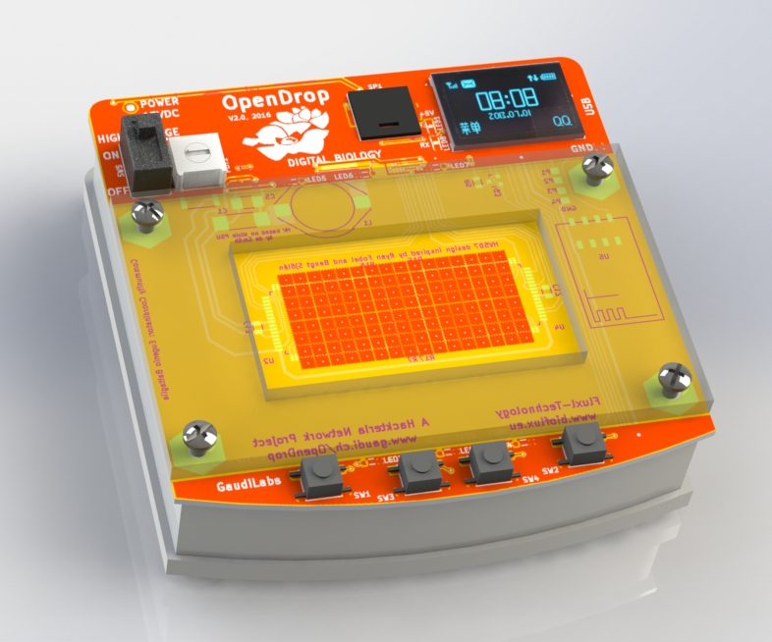
Open source platform for digital microfluidics
Low cost
Automating biology processes
Electrowetting

Slide 3
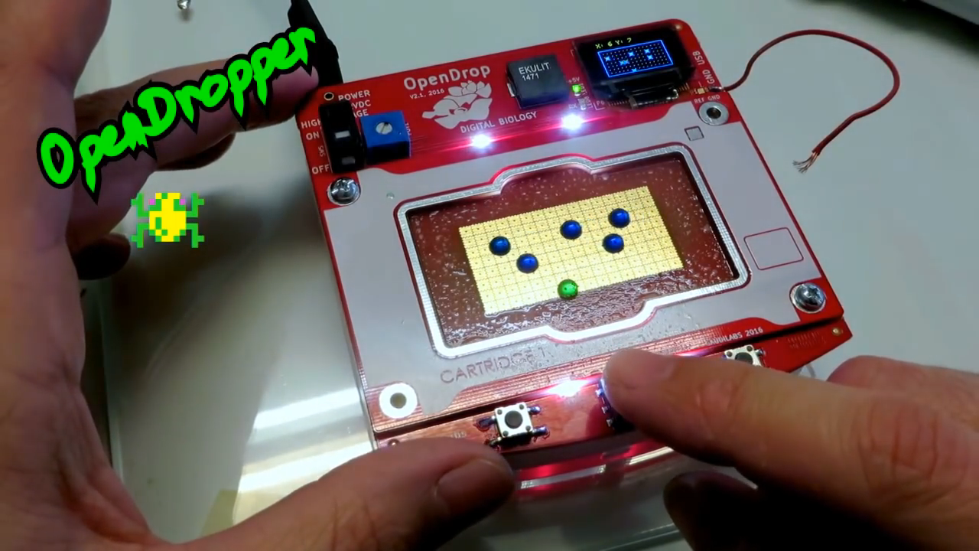

Slide 4
Aims
Familiarizing with the System
Hydrophobic Coating
Topless Experiments
Top-Cover Experiments
OD-Measurement
Documentation
Future Work

Slide 5
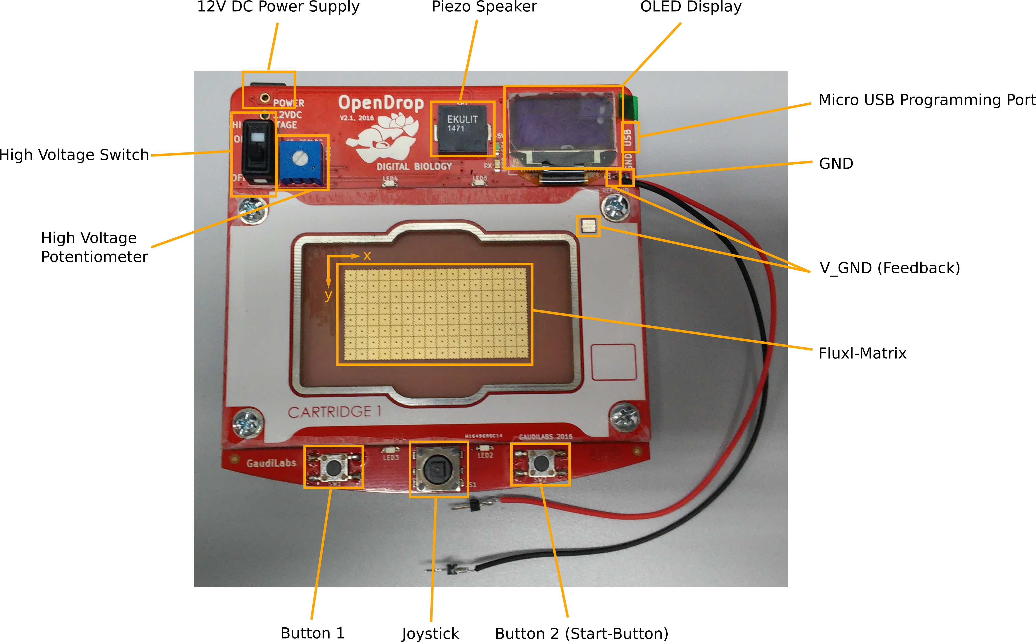

Slide 6
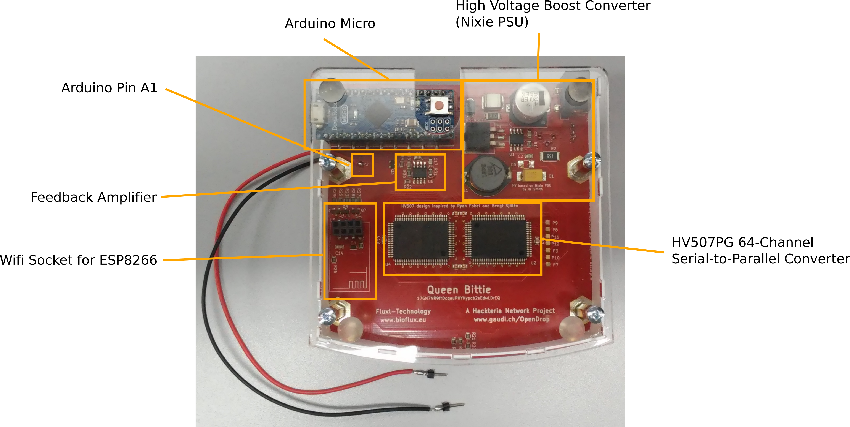

Slide 7
Hydrophobic Coating Materials
Topless Configuration:
Kitchen Foil (Saran Wrap) + RainX
Parafilm + high viscous Silicon Oil (5cst)
PTFE + Silicon Oil
Top-Cover Configuration (advanced):
ETFE Foil + FluoroPel PFC1601V

Slide 8
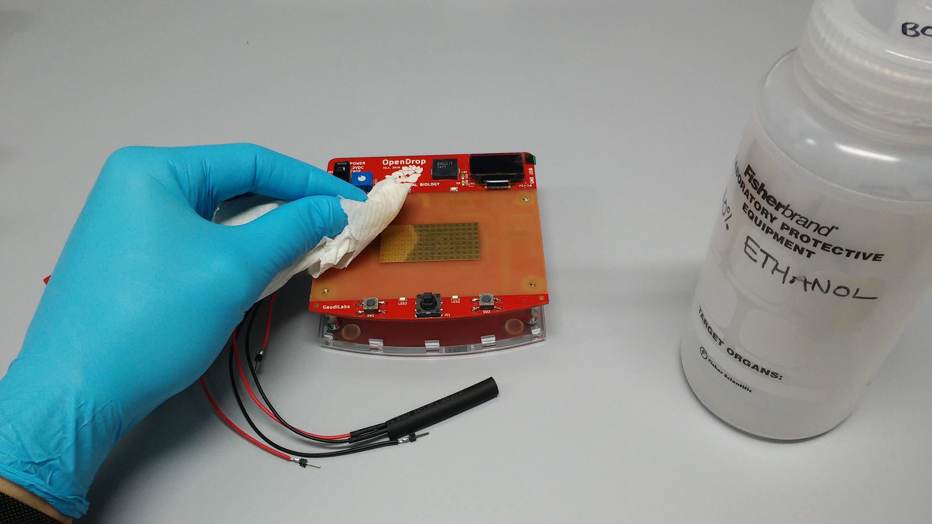
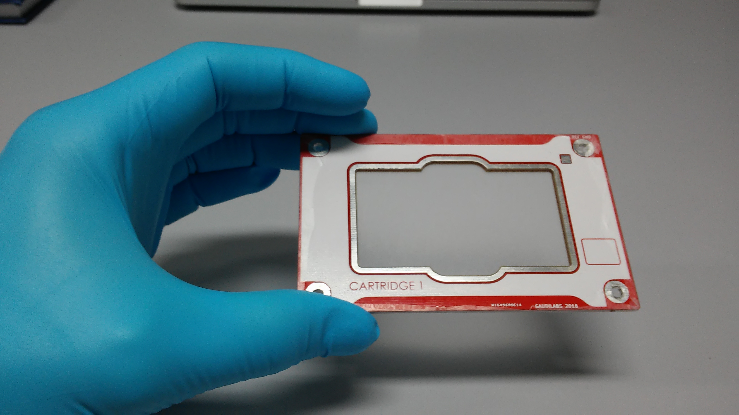
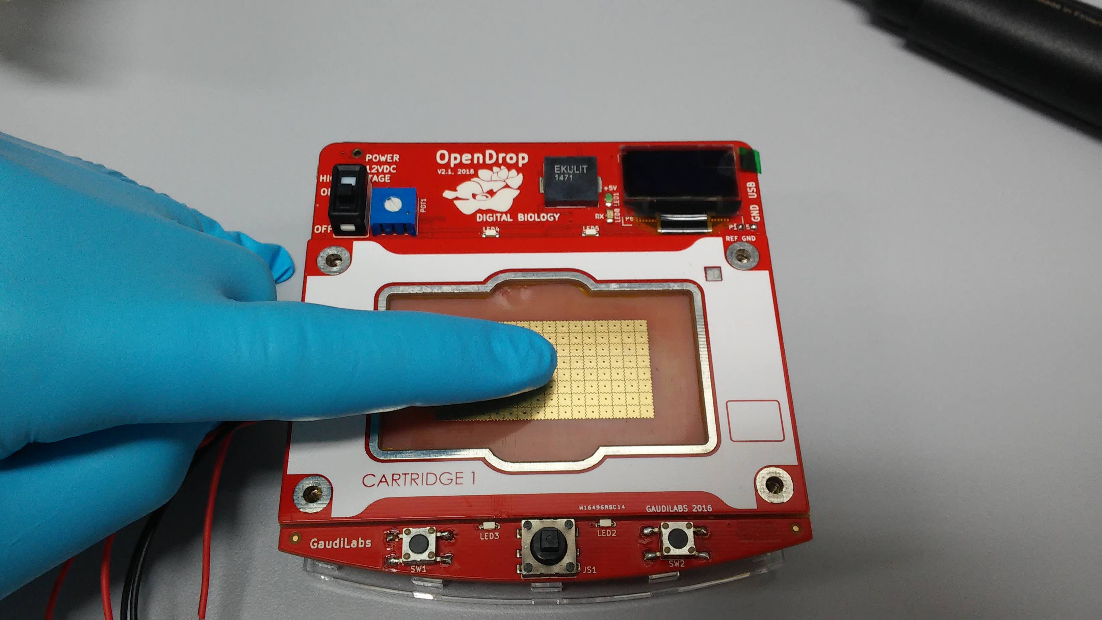
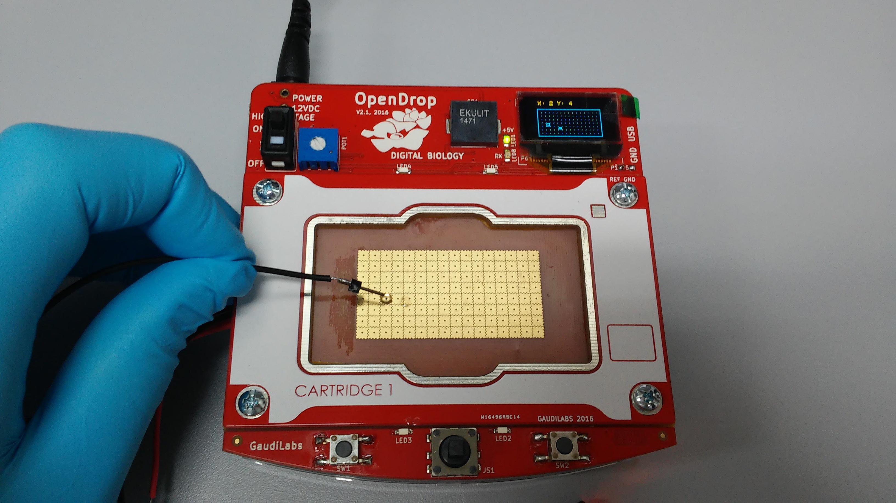
1 – Clean
2 – Apply Parafilm
3 – Apply Silicon Oil
4 - Discharge

Slide 9
Topless Experiments
No closed circuit
Droplets will charge over time
No feedback
Droplet
GND
Coated Foil
250VDC

Slide 10
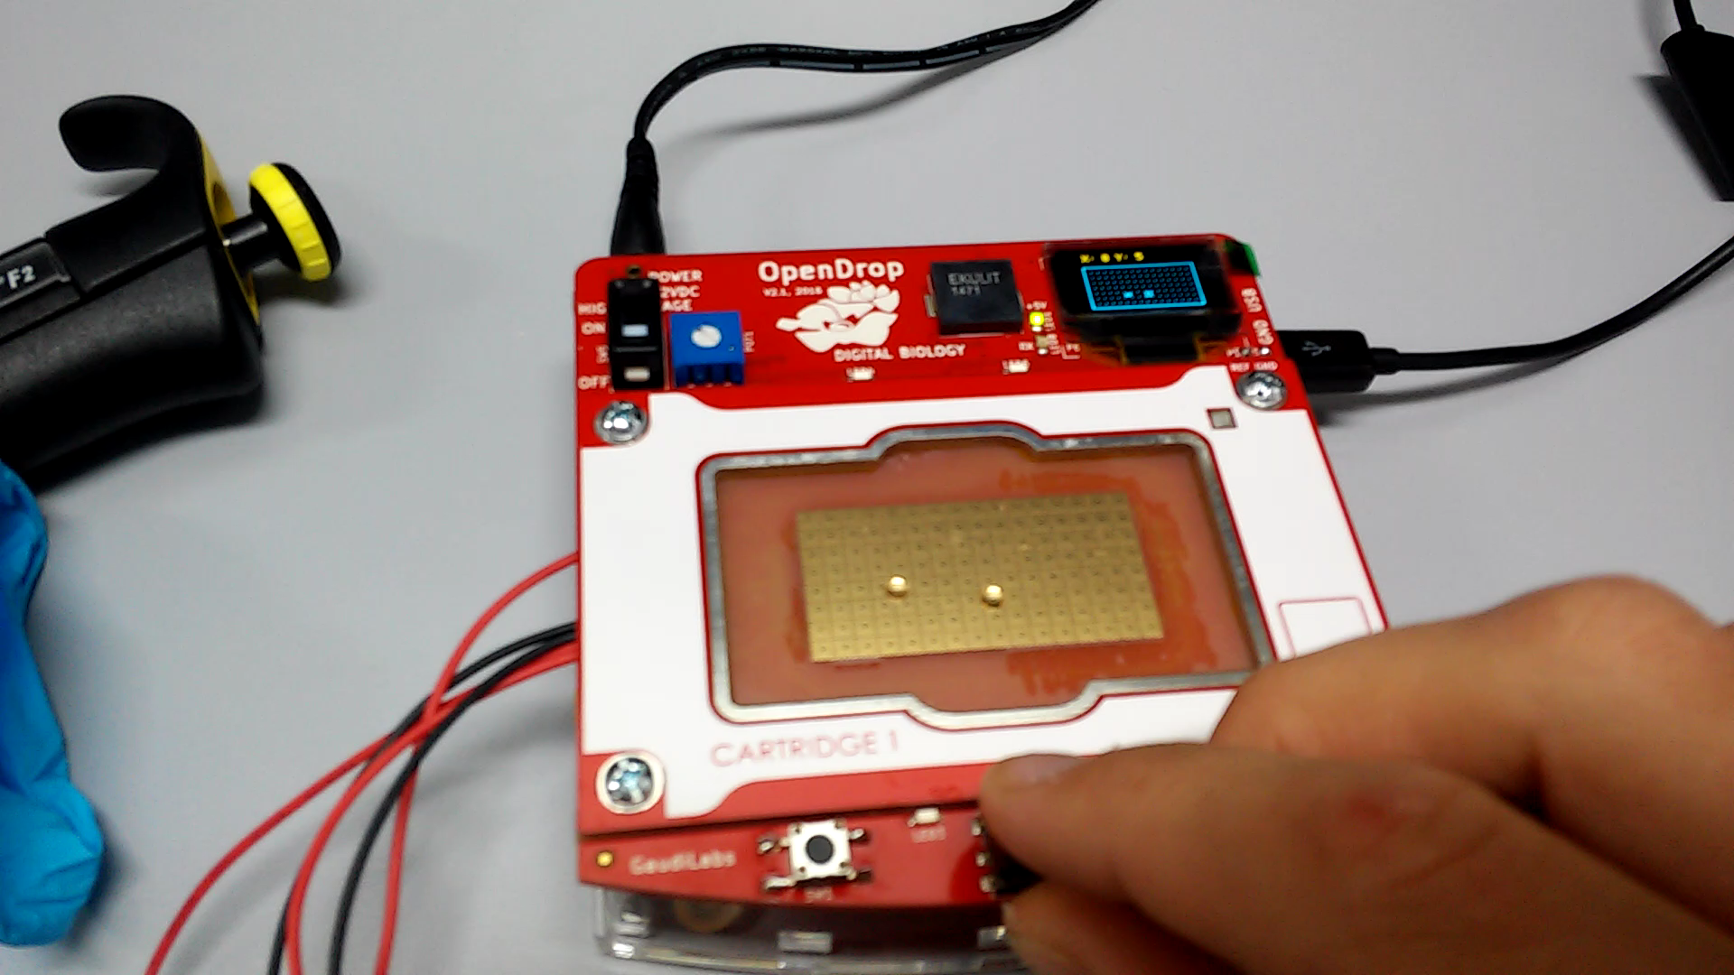

Slide 11
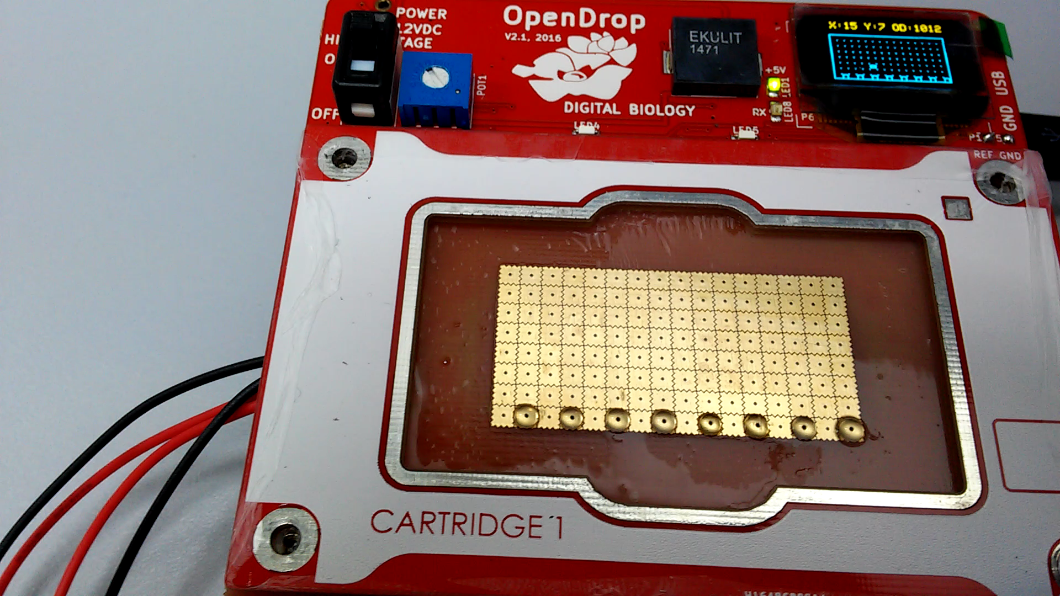

Slide 12
Top-Cover Experiments
Closed circuit
Droplets will be discharged → better movement
Feedback feature can be implemented
ITO-Glass
(conductive, coated)
Droplet
GND
250VDC

Slide 13
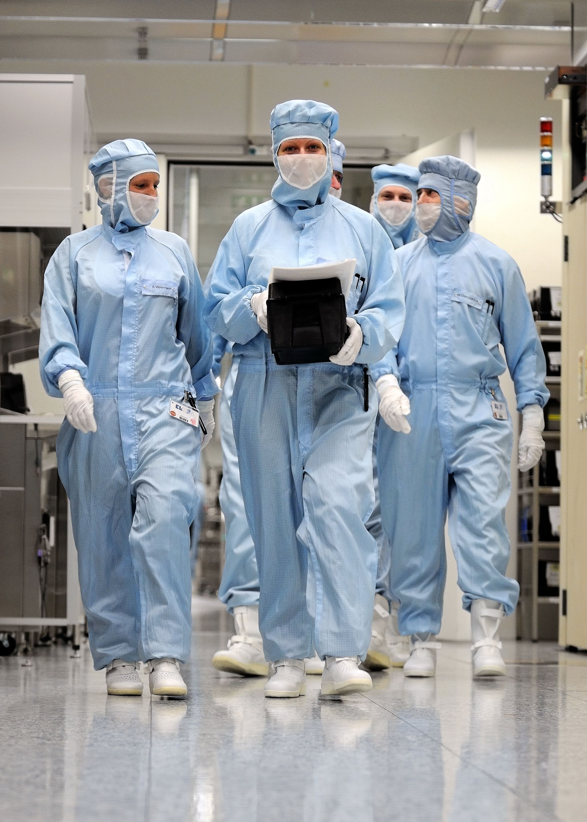
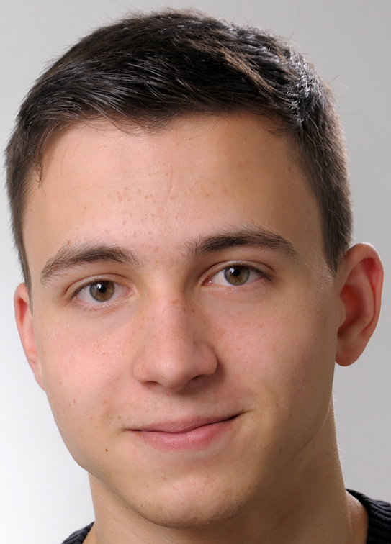
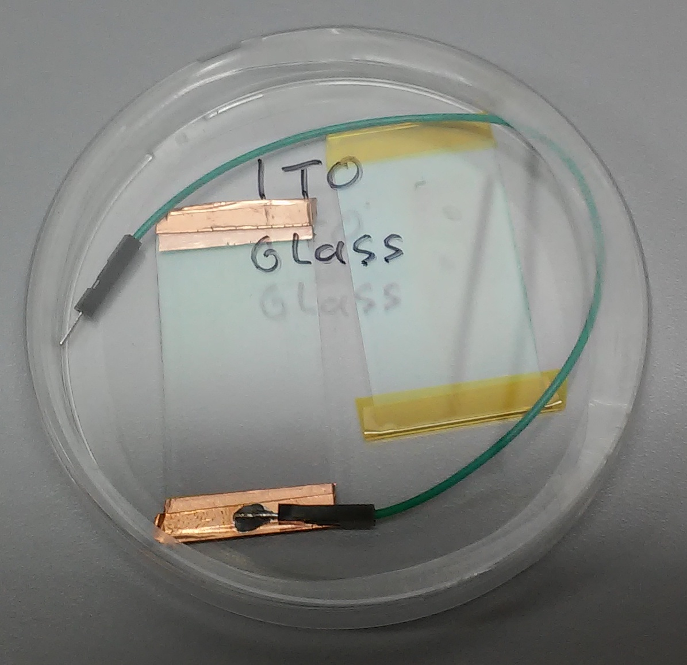
First attempts:
Spin-coating ITO-glass and Parafilm with Silicon Oil
Results:
Droplets stuck on the surface
→ Combination of Parafilm + Silicon Oil in Top-Cover Constellation is not working

Slide 14

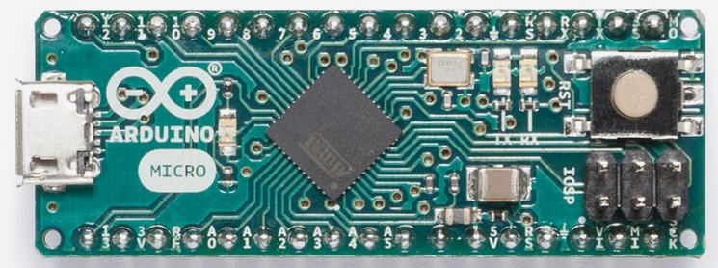
Programming:
Arduino IDE
C++ Library on GitHub
Properties:
Programming via USB
5V Logic Level
32 KB Flash Memory
32 I/O Pins

Slide 15
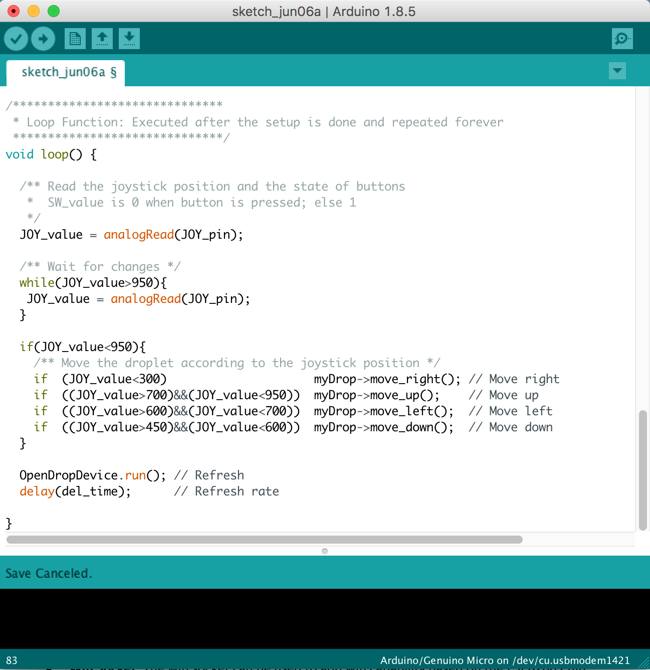
Programming:
Arduino IDE
C++ Library on GitHub
Properties:
Programming via USB
5V Logic Level
32 KB Flash Memory
32 I/O Pins

Slide 16
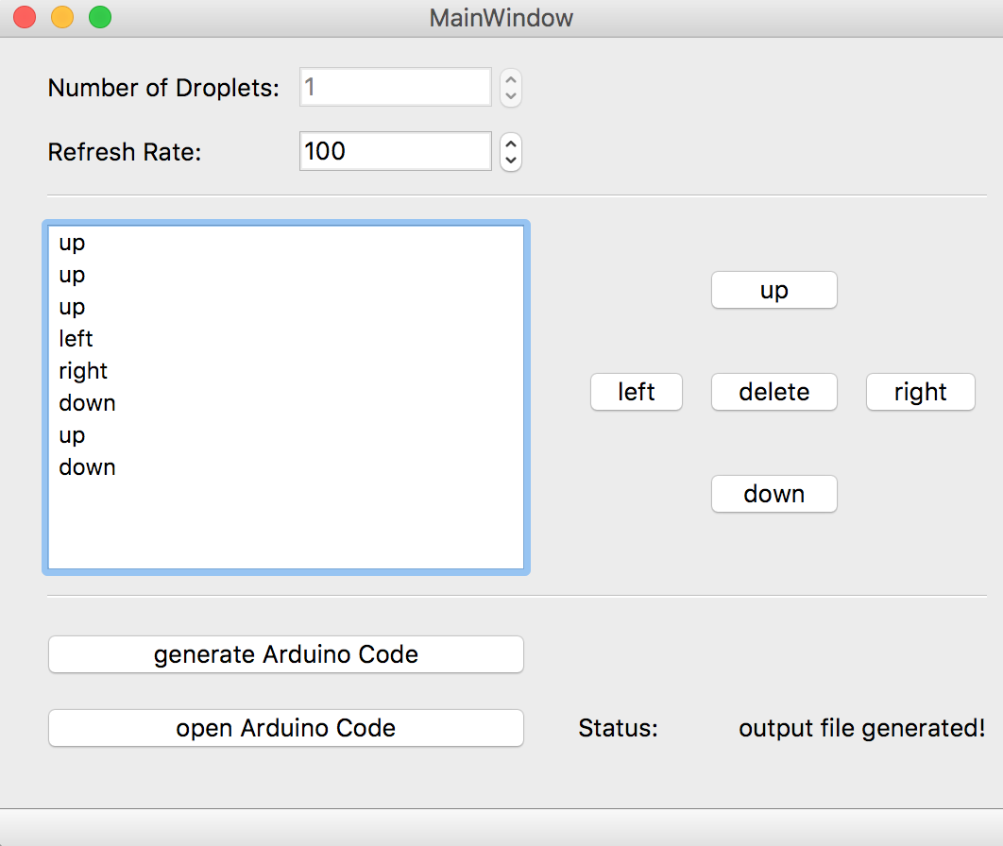
Python GUI for automatic code generation:

Slide 17
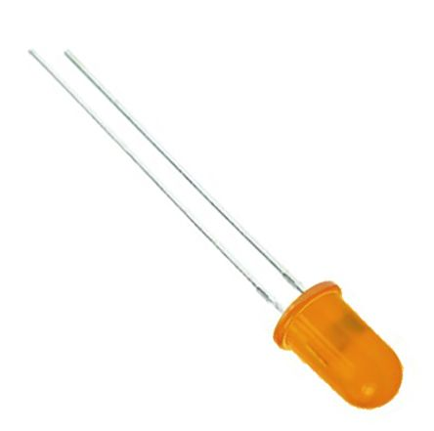
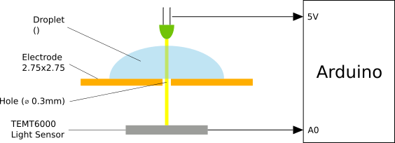
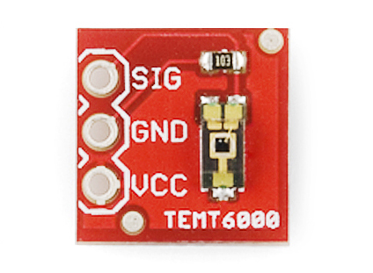
OD-Measurement System
Measure Cell-Concentration of a droplet
600nm LED and light sensor

Slide 18
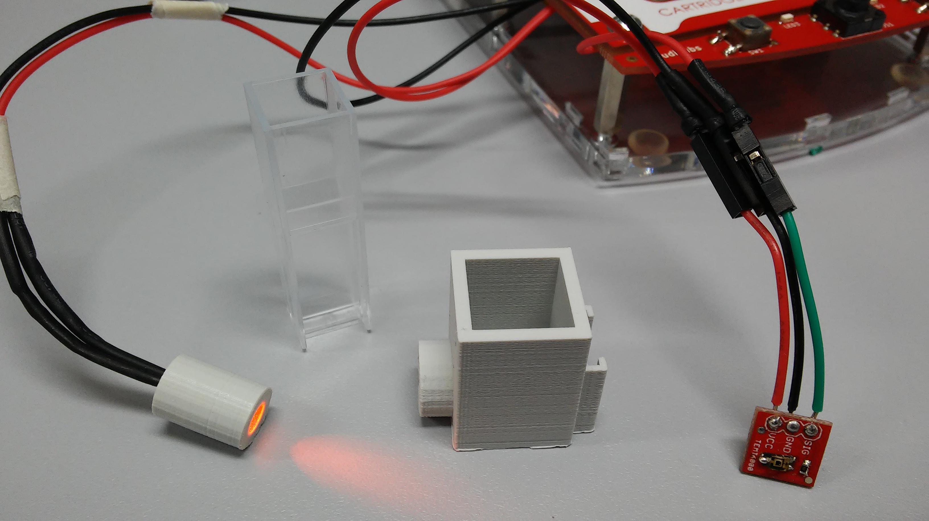
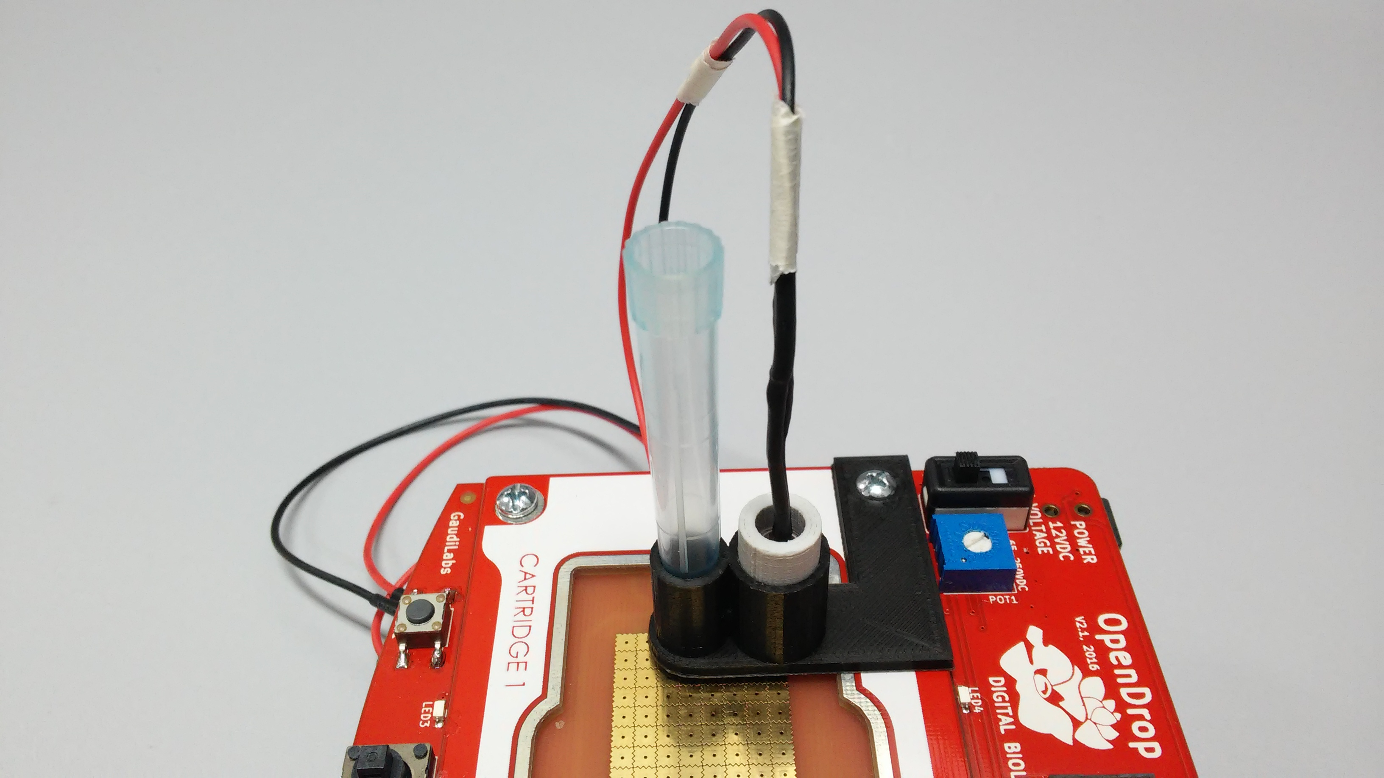
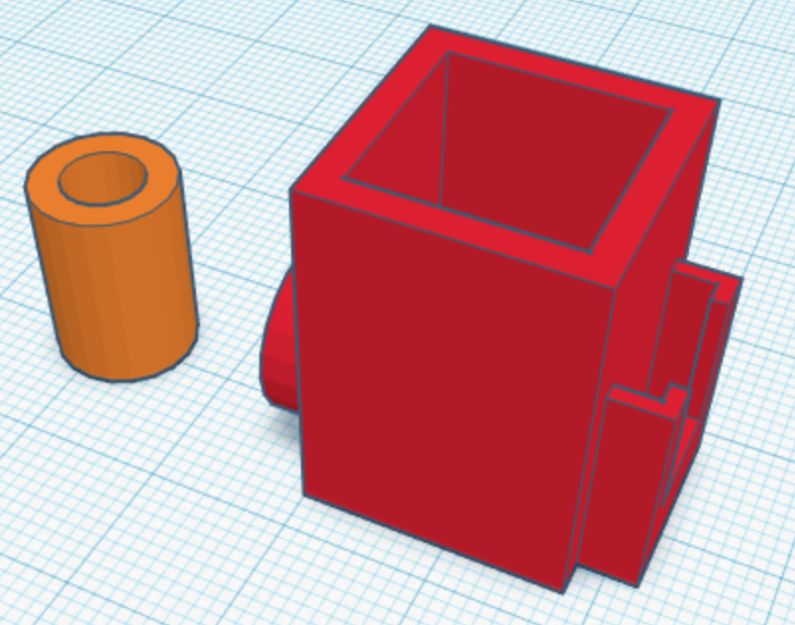
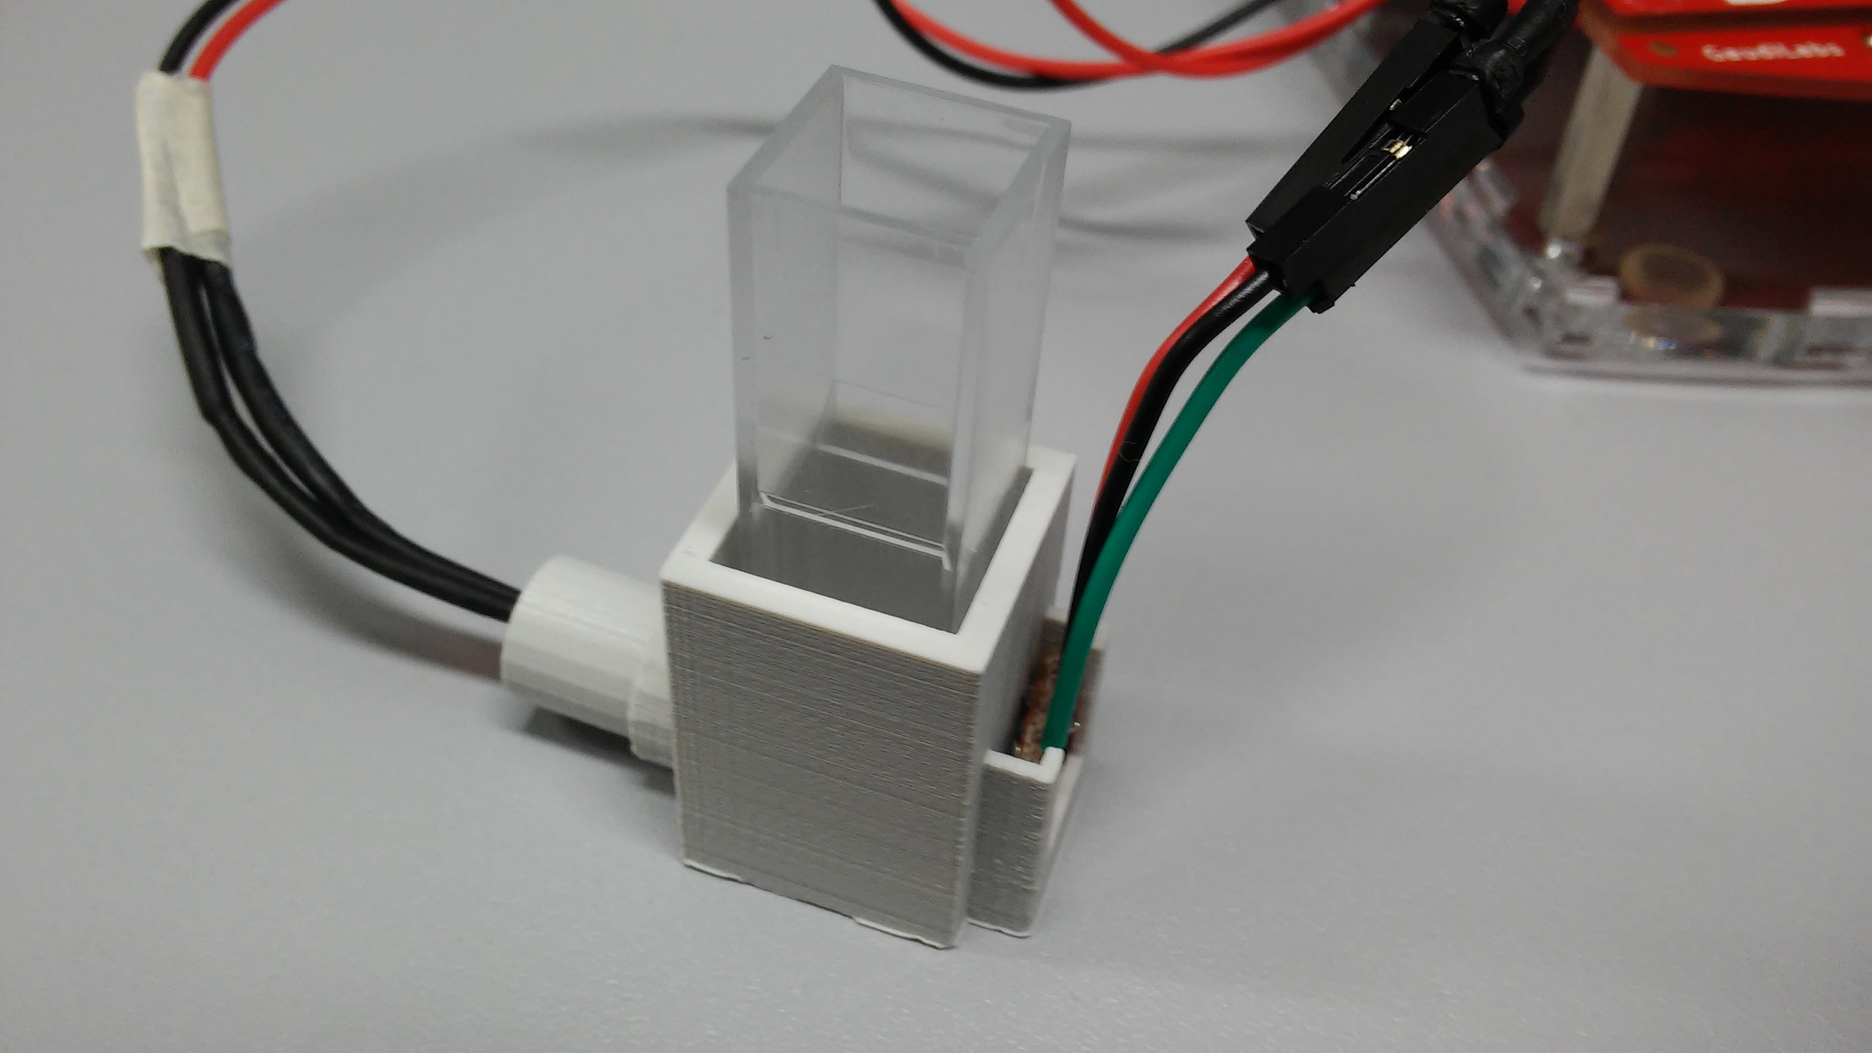
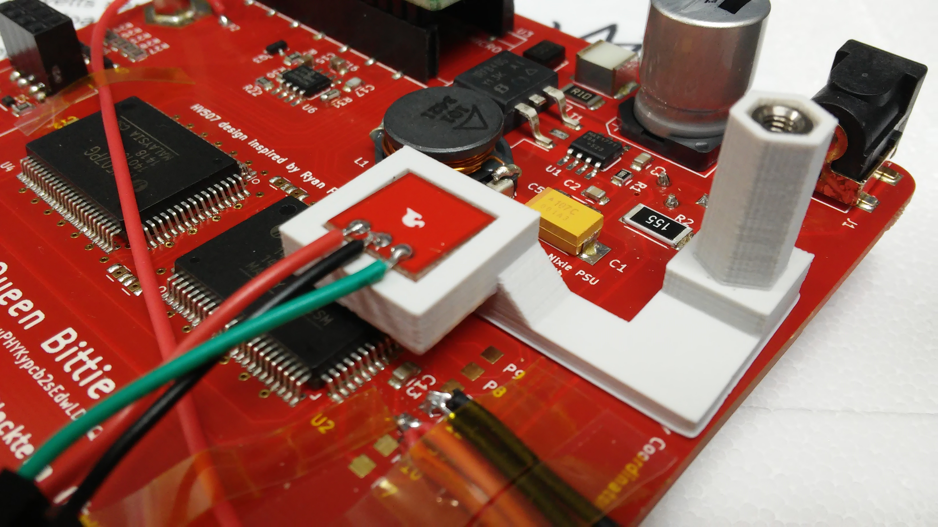
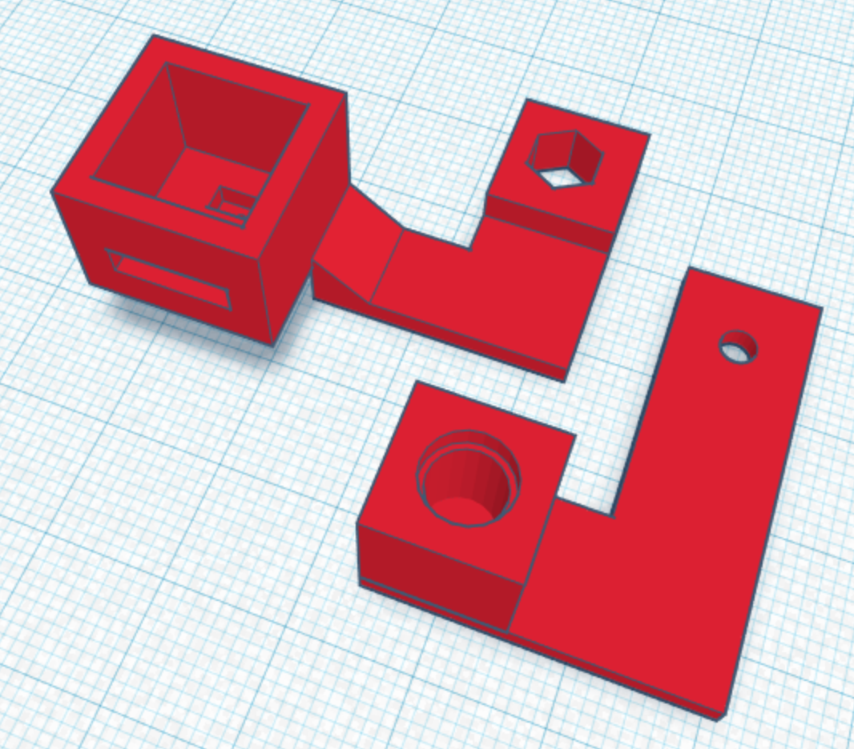
External Setup
Internal Setup

Slide 19
External Setup - Results

Slide 20
Code Documentation
Code-Documentation in Doxygen: → Automatic Creation of HTML-Site → Easy implementation on Github Pages

Slide 21
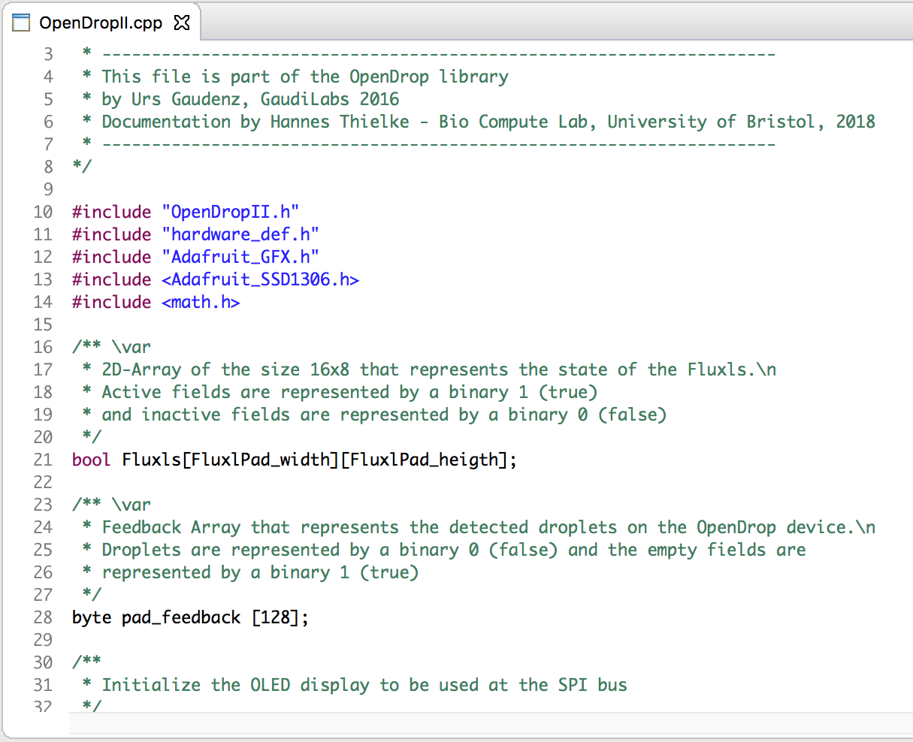
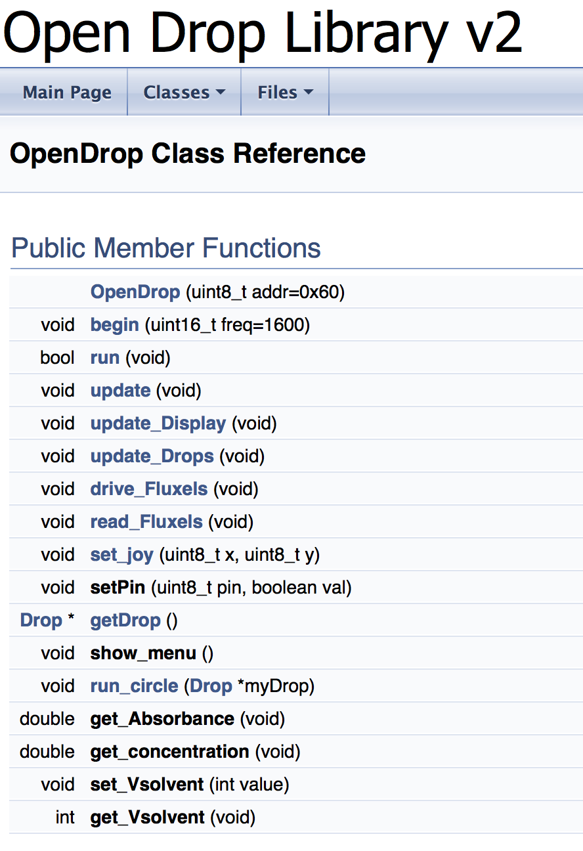
Code Documentation

Slide 22

Code Documentation
Code-Documentation in Doxygen: → Automatic Creation of HTML-Site → Easy implementation on Github Pages
Version control on GitHub → Backups → restoring old code versions and documenting changes → implementing in GitHub Pages

Slide 23
Future Work
ETFE Foil + Fluoropel PFC1601V Coating
Study cell behavior on the electrodes
Top-Cover Setup
Feedback-Loop
Heating electrodes
Liquid Reservoir

Slide 24
Thank you for your attention Questions?

